Slide 1
Stepping Up: A Roadmap for Forming and Sustaining Successful Collaborations
Audra Goldsmith, Kassie Neff
January 16, 2025

Slide 2
Speakers
Kassie Neff, Criminal Justice Programs Manager, Delaware County Sheriff’s Office
Audra Goldsmith, Project Manager, Behavioral Health, CSG Justice Center

Slide 3
Agenda
Welcome and Introductions
Forming a Collaboration
Stepping Up Initiative
Delaware County, OH, Collaborative
Questions and Answers

Slide 4
How We Work
We bring people together.
We drive the criminal justice field forward with original research.
We build momentum for policy change.
We provide expert assistance.
Our Goals
Break the cycle of incarceration.
Advance health, opportunity, and equity.
Use data to improve safety and justice.
We are a national nonprofit, nonpartisan organization that combines the power of a membership association, serving state officials in all three branches of government, with policy and research expertise to develop strategies that increase public safety and strengthen communities.

Slide 5




Initiative
Stepping Up is a national initiative to identify, address, and reduce the number of people with mental illnesses in jails.
#StepUp4MentalHealth
www.StepUpTogether.org

Slide 6
Forming a Collaborative
Functionality and a Recipe for Success

Slide 7
What is a Collaborative Council?
Convening of community stakeholders who meet regularly to address challenges experienced in their systems and work collaboratively and strategically to improve these systems
Originally developed to focus primarily on bettering social issues faced by local jurisdictions (i.e., overcrowding of jails)
Today, they have evolved to focus on public safety, resource allocation, decreasing duplicative services, and more within their local criminal justice systems.
National Association of Counties, “Unlock the Power of CJCCs: Enhance Your County ’s Justice System,” (2024), https://naco.sharefile.com/share/view/s0967c69dcefc40febd06b81c74bab6a7
7
Notes:
Convening of community stakeholders
Who is that? Your decision makers Sheriffs, Judges, Police Chiefs, Prosecutors, MH teams, jail administration, advocacy or lived experience agencies
Original focus on bettering social issues but have expanded to focus on public safety resource allocations and increase utilization of appropriate services and more

Slide 8
Creating a Collaborative Council Leadership and Management Structure
County Commissioners
CJ Coordinator
Judge
Sheriff/Jail Administrator
Behavioral Health Director
District Attorney
Probation Chief
Community Stakeholders
Peers
Notes:
Penix Note: Specifically, we are interested in understanding how such committees—including sheriffs, judges, police chiefs, prosecutors, mental health teams, jail commanders, and others—collaborate to solve problems,
Corrections, Health and Housing, Chief of Police, Voices of those with lived experience

Slide 9
Ensure dollars are being put to good use
Provide input and direction to county decision-makers
Effective means for improving public safety, reducing duplicative services
Create system-based approaches to community issues
Why are collaboratives important?
National Association of Counties, “Unlock the Power of CJCCs: Enhance Your County ’s Justice System,” (2024), https://naco.sharefile.com/share/view/s0967c69dcefc40febd06b81c74bab6a7

Slide 10
How do Collaborative Councils work?
Guide decision-making through data and implementation of best practices.
Provide recommendations to county commissioners, legislators, and other decision-makers.
Facilitate cross-systems coordination resulting in better use of available resources and improved outcomes.
Identify outside funding streams.
National Association of Counties, “Unlock the Power of CJCCs: Enhance Your County ’s Justice System,” (2024), https://naco.sharefile.com/share/view/s0967c69dcefc40febd06b81c74bab6a7

Slide 11
Essential Components
Systemic Focus
Participation
Leadership
Consensus Building
Organized Meetings
Committees and Workgroups
Strategic Planning
Data and Research
Community Engagement
Director and Staff
National Association of Counties, “Unlock the Power of CJCCs: Enhance Your County ’s Justice System,” (2024), https://naco.sharefile.com/share/view/s0967c69dcefc40febd06b81c74bab6a7
Notes:
National Institute of Corrections (NIC) partnered with the Justice Management Institute (JMI) to introduce the national standards for criminal justice coordinating councils (CJCCs).
Systemic Focus- and break down of siloes
Participation of Key leaders- including non-profit organizations who serve justice involved populations; diverse representation reflective of the county
Leadership- plan for structure of the council
Consensus Building- CJCC function as an advisory board, develop recommendations on best practices and next steps; when county leaders know the recommendations are data-driven and agreed upon by the CJCC they are more confident to support them
Organized Meetings- regular meetings consistent days/times, an accessible location
Committees and Workgroups- use additional branching committees and workgroups to get the work done outside of regular meetings
Strategic Planning- Guide developed by data and best practices that align with identified local gaps and needs; living document that needs to be updated regularly
Data & Research- collect key data metrics that drive decision making; track data overtime to assess trends and progress
Community Engagement- encourage community members to actively engage with CJCC beyond membership, attending focus groups, completing surveys
Director and Staff- although not a prerequisite, councils with these positions often known to show better outcomes
National Institute of Corrections, “Guidelines for Developing a Criminal Justice Coordinating Council: Introduction to CJCCs” https://info.nicic.gov/cjcc/node/4
CJCC Essential Elements: A Companion to the National Standards for Criminal Justice Coordinating Councils https://nicic.gov/resources/nic-library/all-library-items/cjcc-essential-elements-companion-national-standards
Guidelines for Developing a Criminal Justice Coordinating Council https://info.nicic.gov/cjcc/
National Association of Counties, “Jail Population Review Teams” (2021) https://www.naco.org/resources/jail-population-review-teams
National Network of Criminal Justice Coordinating Councils https://jmijustice.org/nncjcc/
National Standards for Criminal Justice Coordination Councils https://jmijustice.org/wp-content/uploads/2023/05/NatlStandardsCJCCs.pdf

Slide 12
Key Elements of a Successful Collaboration
Pursues a system that is more just and equitable
Discusses matters productively and professionally to find common ground and possible solutions
Advisory in nature and relies on consensus for decision-making
Responds to crises affecting the criminal justice system
T. Eberly, W. McKay, and A. Wickman, “CJCC Essential Elements: A Companion to the National Standards for Criminal Justice Coordinating Councils,” 2023,
https://nicic.gov/resources/nic-library/all-library-items/cjcc-essential-elements-companion-national-standards

Slide 13
Key Elements of a Successful Collaboration
Includes the perspective of underrepresented communities when making decisions
The strategic plan is specific, measurable, achievable, realistic, and time-bound
The strategic plan includes short-, medium-, and long-term initiatives
Proactively educates and informs the community about the work of the council, including progress and challenges
T. Eberly, W. McKay, and A. Wickman, “CJCC Essential Elements: A Companion to the National Standards for Criminal Justice Coordinating Councils,” 2023,
https://nicic.gov/resources/nic-library/all-library-items/cjcc-essential-elements-companion-national-standards

Slide 14
Stepping Up Initiative
A Guiding Framework

Slide 15
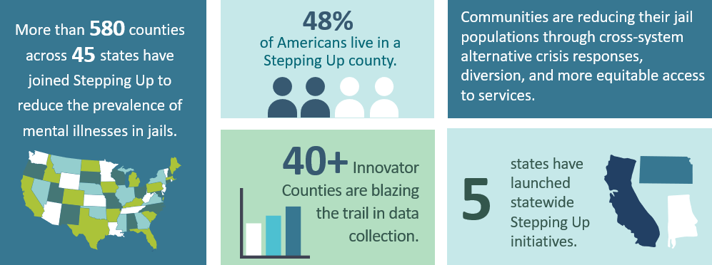
Notes:
Span 580 counties in 45 states, 50 innovator counties or counties who are leading the way in service implementation or policy changes through data driven decisions and
We have 5 states who have launched statewide SU initiatives (PA, KS, OH, AL, CA) and have 2 states (PA and KS) who have Technical Assistance Centers, someone like me to provide one-on-one TA and to be a resource bank for counties as they do this work.

Slide 16

The Stepping Up Six Questions Framework
1
Is our leadership committed?
2
Do we conduct timely screening and assessments?
3
Do we have baseline data?
4
Have we conducted a process analysis and inventory of services?
5
Have we prioritized policy, practice, and funding improvements?
6
Do we track progress?
Notes:
SU has 6 Q’s councils can work through to guide this work

Slide 17





Four Key Measures
1.
2.
Reduce the number of people with mental illnesses booked into jails
Reduce their average lengths of stay in jail
3.
4.
Increase connection to treatment for people who have mental illnesses
Reduce recidivism rates for people who have mental illnesses
Notes:
It is a data driven initiative setting up and supporting counties to have jail based data
We are all aware that our jails serve as the de facto resource for those experiencing a MH crises and are in need of MH resources.
We use data from the jail systems to assess community barriers to resources and success on reducing recidivism. When folks are slipping through the cracks and reaching the jail, this is indication that there is a need in the community and Stepping Up can assist counties in creating cross-systems collaborative teams that utilize data to understand their target population; identify effective policies and strategies to bring to scale and track their progress.

Slide 18
General Recipe for Success with Stepping Up
County commissioners pass Stepping Up resolution.
Designate a Stepping Up coordinator and organize cross-systems council.
Review data and set baselines; implement framework.
Continue to collaboratively use data to drive local policies and practices and pursue funding.
Obtain funding to pilot, expand, or sustain initiatives.
Measure program successes and determine needs with available data.

Slide 19
1. Is Your Leadership Committed?
Why it matters
Meaningful engagement and buy-in is a catalyst for change.
Building consensus creates a shared vision.
What it looks like
Identify core team who will drive initiative and cultivate buy-in.
Develop and implement outreach and engagement plan.
Have a shared commitment to vision, mission, and guiding principles.
Establish shared goals and clearly defined roles and responsibilities.
☑
☑
☑
☑
Notes:
Why it matters
Meaningful engagement and buy-in from key stakeholders is a catalyst for collaboration and systems change
Building consensus around shared goals and responsibilities creates a shared vision and facilitates role clarity
What it looks like
Identify core team who will drive initiative and cultivate buy-in
Develop and implement outreach and engagement plan for key stakeholders
Create representative planning team within new or existing structure
Shared commitment to vision, mission, and guiding principles
Establish shared goals and clearly defined roles and responsibilities

Slide 20
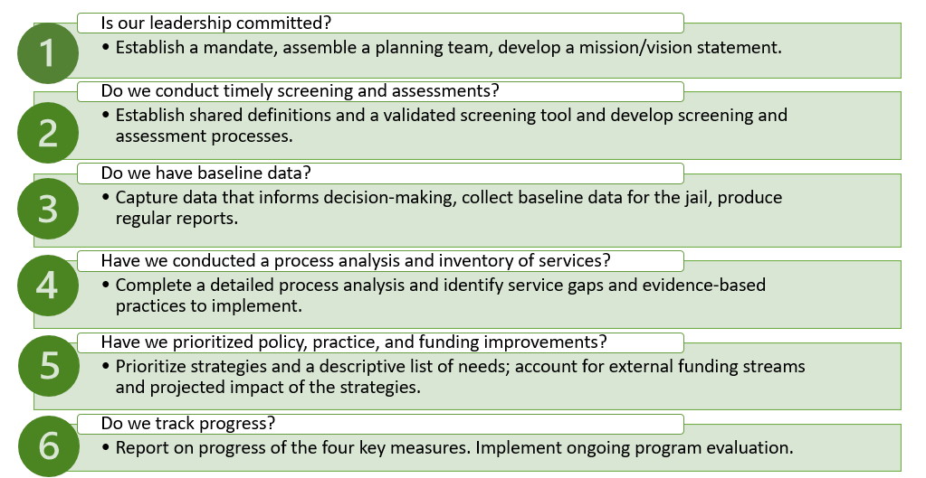
Leveraging Collaboratives to Advance Stepping Up

Slide 21
Kansas Stepping Up TA Center
Notes:
Audra 9-15 slides

Slide 22
Objectives of the TA Center
Establish and implement data-driven plans to reduce the number of people with mental illnesses in local jails.
Create a central information bank for counties across KS on the intersection of mental illness and criminal justice.
Work with the KS Stepping Up Leadership Team to determine state-level policies that can be adjusted or implemented to improve local-level Stepping Up efforts.
Identify best practice sites across the state to act as peer mentors and facilitate connections with other counties.

Slide 23


What is a Stepping Up TA Center?
Kansas
The goal of a Stepping Up TA Center is to help improve the process of identifying community members who have a mental illness and are involved in the justice system. This way, they can be connected to care and, ultimately, counties can reduce recidivism.​
Pennsylvania
Notes:
Through a Stepping Up TA Center, CSG professionals provide tailored and individualized guidance so counties can use accurate baseline data to guide their policies and practice.

Slide 24

Stepping Up Kansas: By the Numbers
98 Counties
Participated in TA Center activities
37 Counties
Engaged with the TA center
22 Counties
Passed SU Resolutions
10 Innovator
Counties

Slide 25
Delaware County Collaborative

Slide 26
Delaware County, Ohio, By the Numbers
2023 Statistics
County
457 Land Area in Square Miles
250,238 Population
Ranked Healthiest County in Ohio by the Robert Wood Johnson Foundation
  Ranked #10 Healthiest County in the U.S. by U.S. News & World Report
Median Family Income: $123,995
Jail
286 Bed Capacity
138 Average Daily Population (ADP)
  12% Mental Health Population
  66% Substance Use Population
  55% Recidivism Rate General Population
  25.5% Recidivism Rate Programs

Slide 27
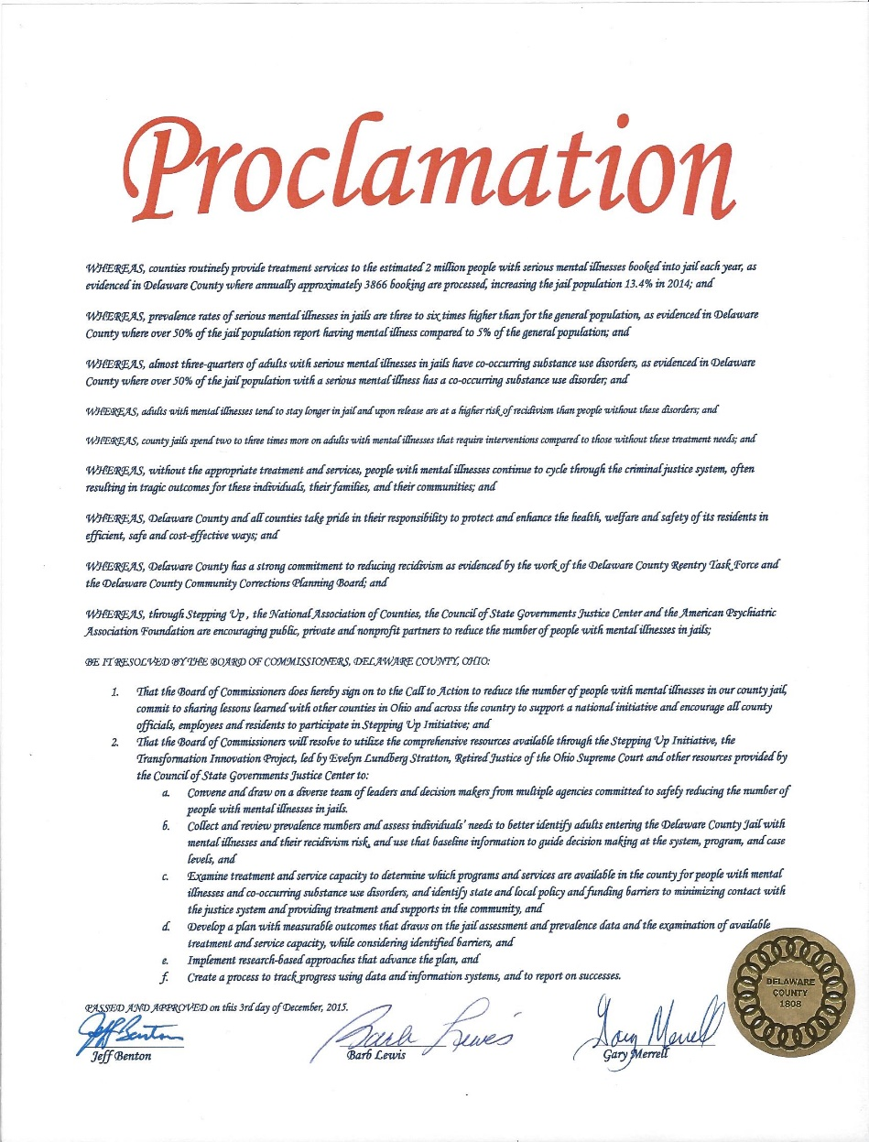
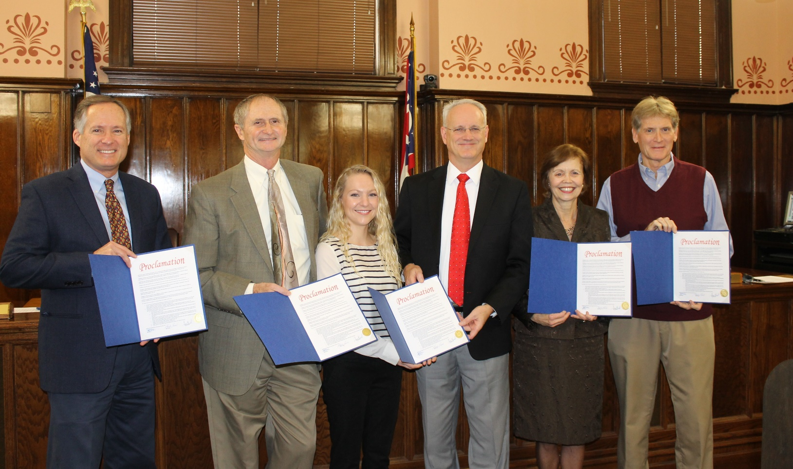
Delaware County Stepped Up in 2015
Notes:
left to right; Commissioners Jeff Benton & Gary Merrell, Delaware County Sheriff’s Office Program Coordinator Kassie Neff, Sheriff Russ Martin, Delaware-Morrow Mental Health & Recovery Services Board Executive Director Steve Hedge, Commissioner Barb Lewis.

Slide 28
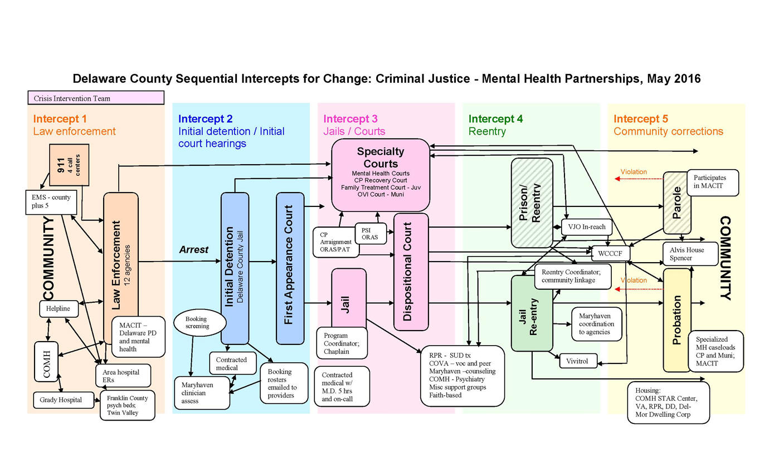
Strategic Planning 2016
5 Priorities for Change
Housing
Transportation
Bed Capacity
Define Mental Illness & Track Data
Jail Data & Information Sharing

Slide 29
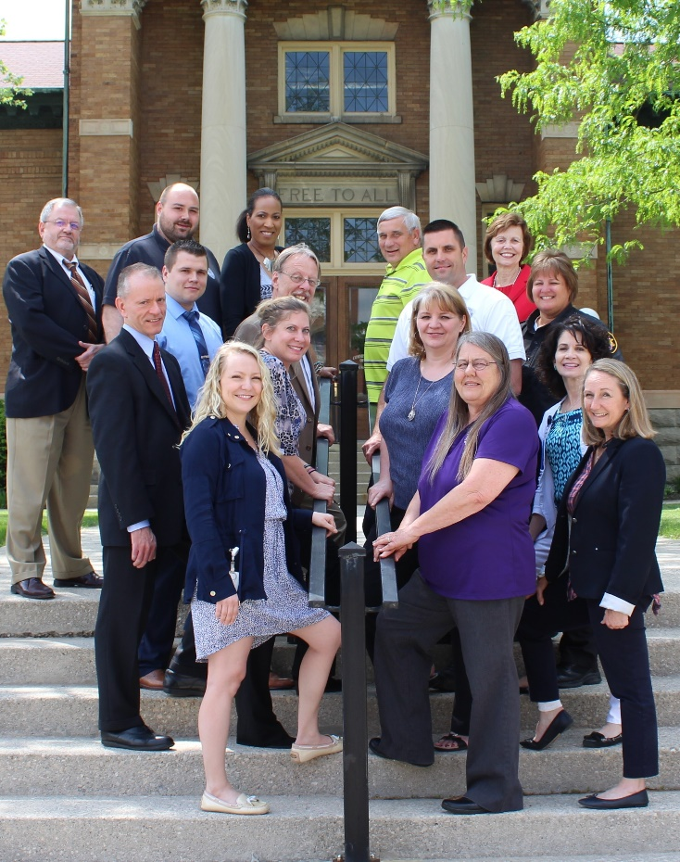
Stepping Up Delaware County
Guided by an Executive Planning Team of local agency and organization leaders
Led by a dedicated Stepping Up coordinator
Operates through 5 priority workgroups
Quarterly meetings with the full committee
Stepping Up Ohio is a vital partner
Notes:
Process:
-Resolution passed Dec. 3, 2015
-Initial Stakeholder Meeting on Jan. 5, 2016
-Core Planning Team group meetings began Jan. 2016
-4 regular meetings
- 1.5 day SIM workshop in May 2016, 50 participants
-State Summit June 2016
-5 priority workgroups have been meeting since May 2016 to advance short-term action items
-Executive Planning team convened Oct 2016 to lead the process of coordinating and implementing the recommendations in the Sequential Intercept Mapping Final Report

Slide 30

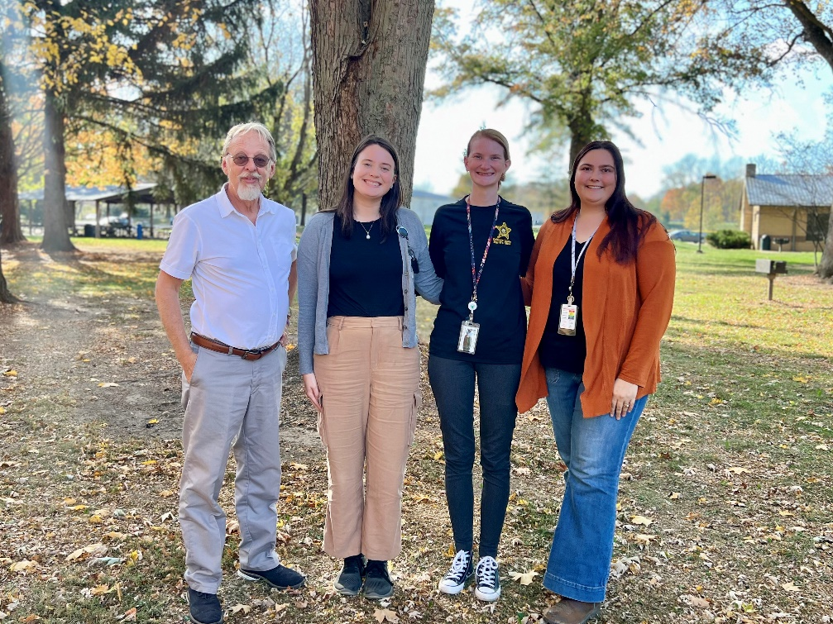


Expanded Jail Programs
LINC—Lives In Need of Connection Program
Jail Programs Manager
Jail Programs Coordinator
Maryhaven Mental Health Clinician
Southeast In-Reach Specialist
Southeast Case Manager

Slide 31
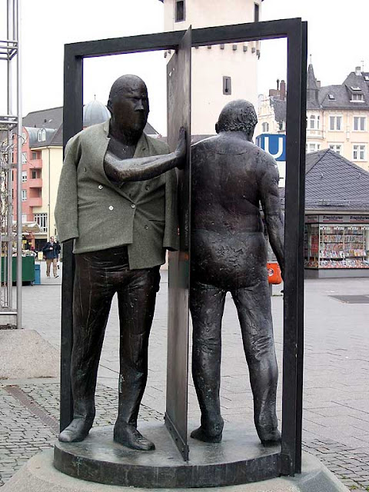
Case Management—Core Component to All Jail Programs
MAT - Medication Assisted Treatment
MRT - Moral Recognation Therapy
Navigation
Father Factor (FF) Program – Action for Children
Education Services - Delaware Area Career Center
Seeking Safety – Salvation Army’s Anti-Human Trafficking Department
The Freedom Collective
Purpose Group – Her Song
Mending Brokenness
Perennial Movement Class
12-Step Recovery Support Meetings
Religious Services
Reentry Case Management
Medicaid for Incarcerated Program
Veteran Justice Outreach (VJO)
Transportation Assistance
Clothing Assistance

Slide 32
Delaware County Data

Slide 33
Spotlights
2018 – Est. Jail Lives In Need of Connection (LINC) program
2019 – Service coordinators embedded in police and fire departments
2019 – Open Recovery Housing
2021 – Est. Jail Medicated Assisted Treatment (MAT) program
2021 – Est. Delaware County Housing Alliance
2022 – Est. 24/7 mental health crisis coverage for jail
2022 – Equine therapy for justice involved
2023 – Opened Transitional Housing for at-risk youth
2023 – Est. Delaware County Guardianship Services Board
2023 – Service coordinator embedded in public defender’s office

Slide 34

Questions and Answers
Notes:
https://www.naco.org/program/criminal-justice-coordinating-councils-hub
The Who, What, and How of Interagency Criminal Justice–Behavioral Health Teams: Developing and Sustaining Collaborations. https://journals.sagepub.com/doi/abs/10.1177/00938548241280391?journalCode=cjbb

Slide 35
Thank You!
Join our distribution list to receive updates and announcements:
https://csgjusticecenter.org/resources/newsletters/
For more information, please contact steppingup@csg.org
This project was supported by Grant No. 15PBJA-22-GK-03568-MENT awarded by the Bureau of Justice Assistance. The Bureau of Justice Assistance is a component of the Office of Justice Programs, which also includes the Bureau of Justice Statistics, the National Institute of Justice, the Office of Juvenile Justice and Delinquency Prevention, the Office for Victims of Crime, and Office of Sex Offender Sentencing, Monitoring, Apprehending, Registering, and Tracking. Points of view or opinions in this document are those of the author and do not necessarily represent the official position or policies of the U.S. Department of Justice.
© 2025 The Council of State Governments Justice Center

Slide 36
Cycle of Stepping Up Support
SU Develops
Broad-Based TA Tools
Web tools
Webinars, briefs, case studies
Feature county successes
Counties Achieve Success
Program successes: quantitative and qualitative
Reductions in Key Measures 1, 2, or 4 or Increase on Key Measure 3
SU Delivers Site-Based/Small-Group TA
State TA Centers
JMHCP Category 1 Grantees
Intensive sites
Communities of practice
1:1 support via help desk
Counties Implement Strategies from TA
Obtain accurate data and set baselines
Implement programs and practices
Measure progress

Slide 37
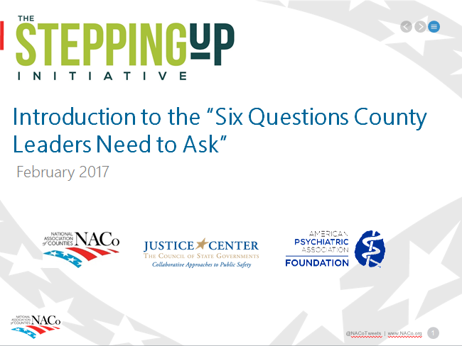
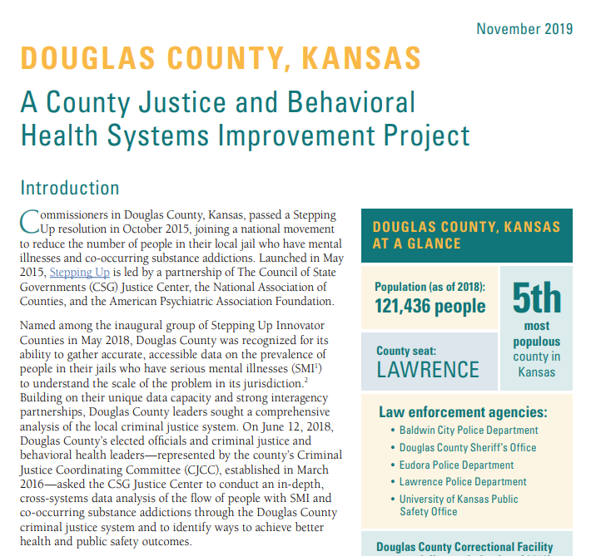
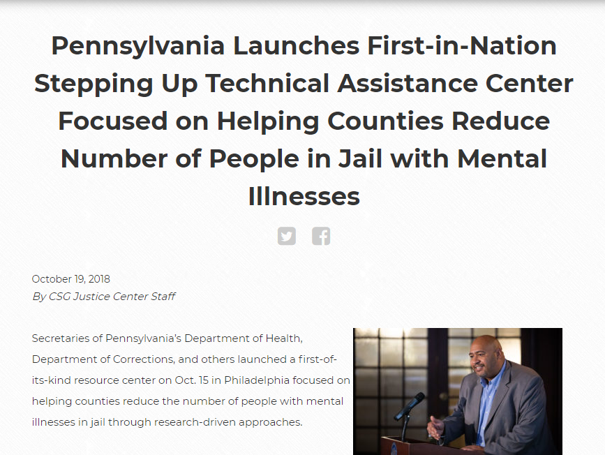
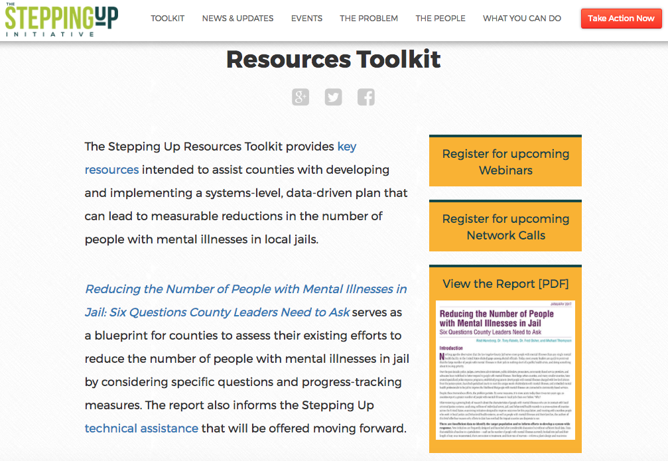
Multiple Levels of Technical Assistance (TA)
  Broad-Based TA
  County-Level TA
  State Initiatives
Notes:
Our SU team provides multiple levels of TA including:
Broad-Based TA: filed wide open webinars, available resources on our webpage
County-level TA: assisting a county address a specific challenge
State Initiatives- support SU statewide via our SU Team and/or a designated TA Center

Slide 38
Leveraging Collaboratives to Advance Stepping Up
Depending upon composition of collaborative, this may be the group that works through the Stepping Up framework together OR a committee/subgroup can be formed.
Meet routinely to walk-through Stepping Up framework
Work together to gather and review key data indicators
Discuss and reach consensus around relevant programs, policies, and processes to move the needle on this important issue.
Notes:
Strongly suggest having a person on the CJCC to serve as the SU Coordinator- someone who is knowledgeable with the framework, the data abilities and capacity- to advance this specific work at BH and the jail and justice system
This can function with the CJCC or be a subcommittee, but the main takeaway is SU is not a replacement but complimentary and in my opinion, a significant benefit and strengthening component to a CJCC

Slide 39






Is our leadership committed?
Do we conduct timely screening and assessments?
Do we have baseline data?
Have we conducted a process analysis and inventory of services?
Have we prioritized policy, practice, and funding improvements?
Do we track progress?
Establish a mandate, assemble a planning team, develop a mission/vision statement.
Establish shared definitions and a validated screening tool and develop screening and assessment processes.
Capture data that informs decision-making, collect baseline data for the jail, produce regular reports.
Complete a detailed process analysis and identify service gaps and evidence-based practices to implement.
Prioritize strategies and a descriptive list of needs; account for external funding streams and projected impact of the strategies.
Report on progress of the four key measures. Implement ongoing program evaluation.
Notes:
SU has 6 Q’s councils can work through to guide this work

